Slide 1
HKBK COLLEGE OF ENGINEERING
PROJECT TITLE: CONTACT MANAGER APP
TEAM MEMBERS
NANDINI K S 1HK22CS097
GEO SELCIYA 1HK22CS048
NANDINI H S 1HK22CS096
HARSHITHA S 1HK22CS046
VARSHINI M N 1HK22EC179
DEPT: COMPUTER SCIENCE AND ENGINEERING
DOMAIN: MERN STACK
MENTOR: QANITHULLAKHAN

Slide 2
About the Contact Manager Application
The Contact Manager is a Python-based application designed to store, organize, and manage contact information efficiently. It allows users to create, view, search, update, and delete contact records, ensuring that personal or professional contact details are easily accessible.
The application uses a JSON file for data storage, enabling persistence of information between sessions without requiring a complex database setup. This makes it lightweight, portable, and easy to maintain. The codebase is structured into separate modules to enhance readability, reusability, and scalability.

Slide 3
Purpose
The main objective of this project is to provide a simple yet functional contact management tool that can be used from the command line. It also serves as a foundation for learning basic file handling, data structures, and modular programming in Python.
Key Features
Add Contact – Store a new contact’s name, phone number, email address, and physical address.
View Contacts – Display all stored contacts in a clear, organized list.
Search Contact – Find contacts by name, with partial matching support.
Update Contact – Edit existing contact details while keeping unchanged fields intact.
Delete Contact – Remove unwanted or outdated contacts.
Data Persistence – All changes are saved automatically to a JSON file.

Slide 4
Advantages
Simple and lightweight
No need for internet connection or database setup
Modular structure for easy maintenance
Can be extended into a GUI or web-based app
Future Enhancements
Graphical User Interface (GUI) using Tkinter or PyQt
Import/Export Contacts in CSV or Excel format
Cloud Synchronization for multi-device access
Contact Grouping (e.g., Family, Friends, Work)

Slide 5
Project Structure
>contactmanager
>Backend
└node modules
└app.js
└package.json
>Frotnend
└index.html
└script.js
└style.css

Slide 6
HTML CODE
<!DOCTYPE html>
<html lang="en">
<head>
<meta charset="UTF-8">
<title>Contact Manager</title>
<link rel="stylesheet" href="style.css">
</head>
<body>
<h1>Contact Manager</h1>
<form id="contactForm" method="post" action="/contacts">
<input type="hidden" id="contactId">
<input type="text" name="name" id="name" placeholder="Name" required>
<input type="email" name="email" id="email" placeholder="Email" required>
<input type="text" name="phnumber" id="phnumber" placeholder="Phone" required>
<button type="submit">Save Contact</button>
<ul id="contactList"></ul>
</form>
<script src="script.js"></script>
</body>
</html>

Slide 7
CSS CODE
body {
font-family: Arial, sans-serif;
padding: 20px;
max-width: 600px;
margin: auto;
}
form input, form button {
display: block;
margin: 10px 0;
padding: 8px;
width: 100%;
}
li {
margin: 10px 0;
border-bottom: 1px solid #ccc;
padding: 5px;
}

Slide 8
Script.js
const apiUrl = 'http://localhost:3000/contacts';
const contactForm = document.getElementById('contactForm');
const contactList = document.getElementById('contactList');
const contactId = document.getElementById('contactId');
const nameInput = document.getElementById('name');
const emailInput = document.getElementById('email');
const phoneInput = document.getElementById('phone');
async function fetchContacts() {
const res = await fetch(apiUrl);
const contacts = await res.json();
displayContacts(contacts);
}
function displayContacts(contacts) {
contactList.innerHTML = '';
contacts.forEach(contact => {
const li = document.createElement('li');
li.innerHTML = `
<strong>${contact.name}</strong><br>
${contact.email} | ${contact.phone}<br>
<button onclick="editContact(${contact.id})">Edit</button>
<button onclick="deleteContact(${contact.id})">Delete</button>
`;
contactList.appendChild(li);
});
}

Slide 9
.
const id = contactId.value;
if (id) {
await fetch(`${apiUrl}/${id}`, {
method: 'PUT',
headers: { 'Content-Type': 'application/json' },
body: JSON.stringify(contact)
});
} else {
await fetch(apiUrl, {
method: 'POST',
headers: { 'Content-Type': 'application/json' },
body: JSON.stringify(contact)
});}contactForm.reset();
contactId.value = '';
fetchContacts();
});
async function editContact(id) {
const res = await fetch(`${apiUrl}`);
const contacts = await res.json();
const contact = contacts.find(c => c.id === id);
contactId.value = contact.id;
nameInput.value = contact.name;
emailInput.value = contact.email;
phoneInput.value = contact.phone;
}
async function deleteContact(id) {
await fetch(`${apiUrl}/${id}`, { method: 'DELETE' });
fetchContacts();
}
fetchContacts();

Slide 10
Server.js
// Add a new contact
app.post('/contacts', (req, res) => {
const contact = { id: idCounter++, ...req.body };
contacts.push(contact);
res.status(201).json(contact);
});
// Update contact
app.put('/contacts/:id', (req, res) => {
const id = parseInt(req.params.id);
const index = contacts.findIndex(c => c.id === id);
if (index !== -1) {
contacts[index] = { id, ...req.body };
res.json(contacts[index]);
} else { res.status(404).json({ message: 'Contact not found' });
}
});
const express = require('express');
const cors = require('cors');
const app = express();
const PORT = 3000;
app.use(cors());
app.use(express.json());
let contacts = [];
let idCounter = 1;
// Get all contacts
app.get('/contacts', (req, res) => {
res.json(contacts);
});

Slide 11
// Delete contact app.delete('/contacts/:id', (req, res) => { const id = parseInt(req.params.id); contacts = contacts.filter(c => c.id !== id); res.json({ message: 'Contact deleted' }); }); app.listen(PORT, () => { console.log(`Server running at http://localhost:${PORT}`); });

Slide 12
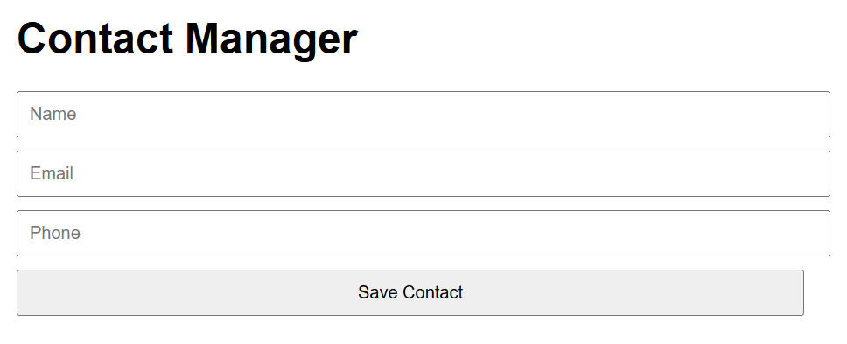
OUTPUT :

Slide 13
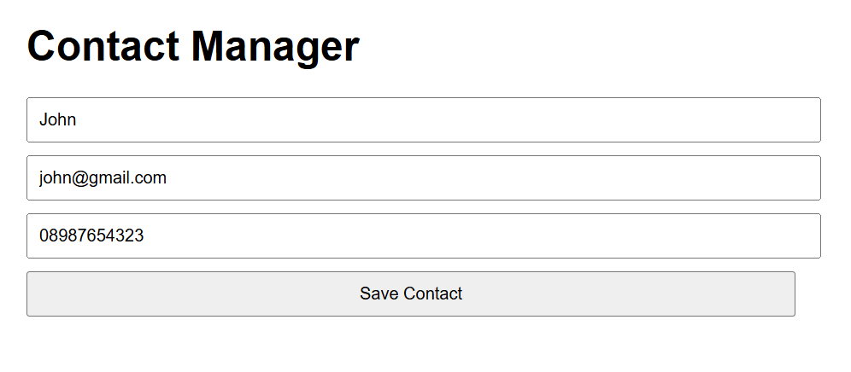

Slide 14
THANK YOU

